Slide 1
20XD14 -Problem Solving and C Programming

Slide 2
Outline
Problem Solving
Program Development Steps
  Define the Problem
  Outline the Solution
  Develop Algorithm
  Test the Algorithm for Correctness
  Code the Algorithm
  Compile
  Run the Program
  Test, Document and Maintain the Program
Programming Language
History of C
Why learn C?
Typical C Program Development Environment
Structure of a C program
Simple C programs

Slide 3
Problem Solving
The process of taking the statement of a problem and developing a computer program that solves that problem
Programming - a problem-solving activity
Computer Program
  A computer program is a set of formal instructions, which the computer executes in order to carry out some designated task

Slide 4
Program Development Steps
1. Define the Problem
  First of all, the problem should be clearly defined
  The problem can be divided into three components
    Inputs – What do you have?
    Outputs – What do you want to have?
    Processing – How do you go from inputs to outputs?
Programmers should clearly understand “what are the inputs to the program”, “what is expected as output(s)” and “how to process inputs to generate necessary outputs”

Slide 5
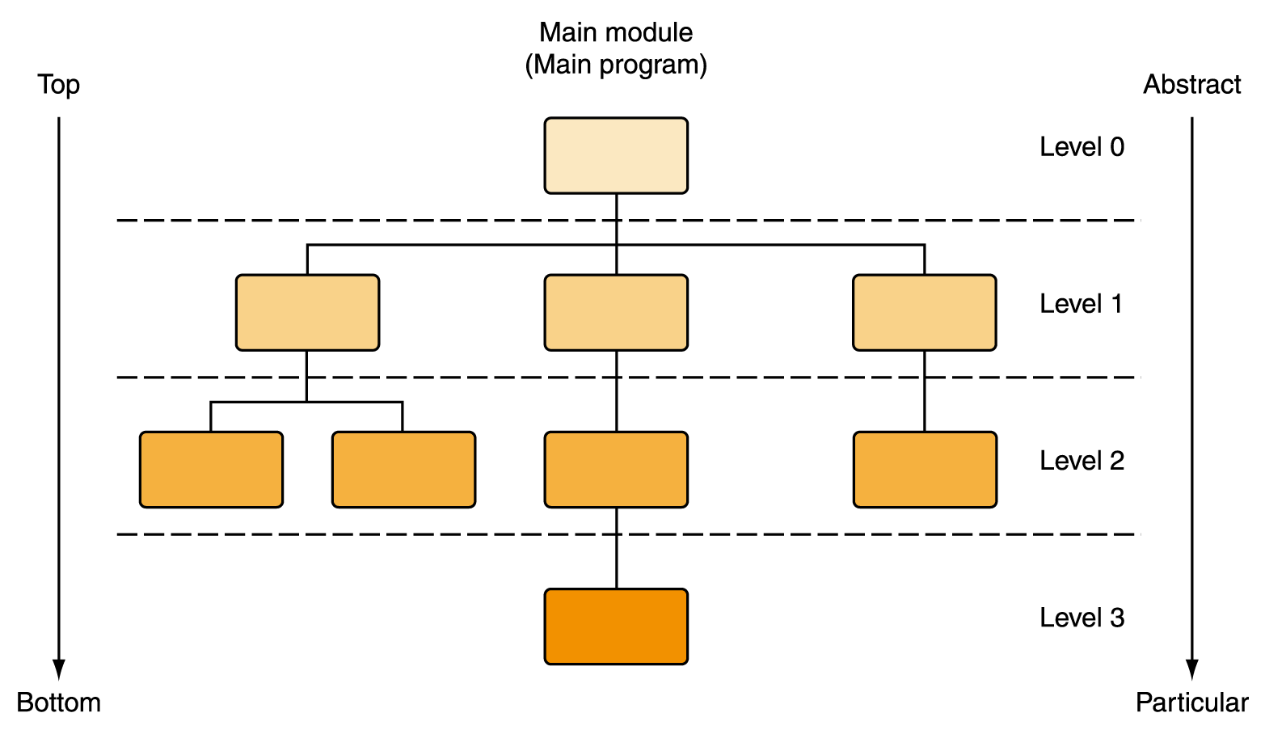
Program Development Steps
Example : A computer program is to be written to calculate and display the circumference and area of a circle when the radius is r
    Inputs: the radius (r)
    Outputs: circumference (c) and area (a)
    Processing: c = 2πr, a = π r²
2. Outline the Solution
  The programmer should define
    the major steps required to solve the problem
    any subtasks
    the major variables and data structures
    the major control structures (e.g. sequence, selection, repetition loops) in the algorithm
    the underlined logic

Slide 6
Program Development Steps
Example - Calculate and display the circumference and area of a circle when the radius is r
  In order to calculate the circumference
  Variables: radius (r), circumference (c)
  Calculation: c = 2πr
  In order to calculate the area
  Variables: radius (r), area (a)
  Calculation: a = πr²

Slide 7
Program Development Steps
3. Develop the Algorithm
An algorithm is a well defined finite number of ordered Instructions which takes input and gives correct output
Efficiency of an algorithm can be evaluated on the basis of following parameters.
Time complexity
  The amount of computer time required by the algorithm for its execution.
Space complexity
  Refers to the amount of memory required by the algorithm for its execution and generation of final output

Slide 8
Characteristics of Algorithm
Input
  Takes zero or more inputs
Output
  Can be proved to produces the correct output, given a valid input
  One or more outputs may result
Finiteness
  Terminates after a finite number of steps
  All operations are carried out in finite time
Definiteness
  Each step must be readable, understandable and unambiguously specified
Effectiveness
  Steps are sufficiently simple and basic

Slide 9
Program Development Steps
  Designing the algorithm to solve a problem requires to develop a list of steps to solve a problem and to then verify that the algorithm solves the problem as intended
  Pseudocode - an artificial and informal language that helps programmers develop algorithms. Pseudocode is very similar to everyday English
  For Example
    Write an algorithm to determine a student’s final grade and indicate whether it is pass or fail. The final grade is calculated as the average of four marks

Slide 10
Pseudocode & Algorithm
Pseudocode
Input a set of 4 marks
Calculate their average by summing and dividing by 4
if average is below 50
Print “FAIL”
else
Print “PASS”

Slide 11
Pseudocode & Algorithm
Detailed Algorithm
Step 1: Input M1,M2,M3,M4
Step 2: GRADE ← (M1+M2+M3+M4)/4
Step 3: if (GRADE < 50) then
Print “FAIL”
else
Print “PASS”
endif

Slide 12
Program Development Steps
  Calculate the circumference and area of a circle
    Step 1: Start
    Step 2 : Input r
    Step 3 : Calculate circumference c = 2 * PI* r
    Step 4 : Calculate area a = PI * r ^ 2
    Step 5 : Output c & a
    Step 6 : End
Notes:
pseudocode is a simple and concise sequence of English-like instructions to solve a problem.

Slide 13
Program Development Steps
Algorithm : To find largest of three numbers
  Step 1 : Start
  Step 2 : Read 3 numbers: num1, num2, num3
  Step 3 : if num1 > num2 then
  Step 4 : if num1 > num3 then
  print num1 is largest
  else
  print num3 is largest
  Step 5 : else if num2 > num3 then
  print num2 is largest
  else
  print num3 is largest
  Step 6 : End
num1= 10
num2= 5
num3= 11

Slide 14
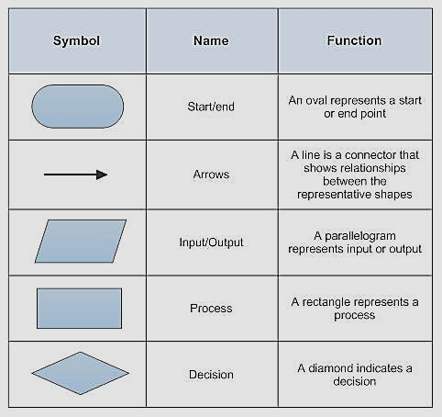
Program Development Steps
Flow Chart
  It is a pictorial representation of the algorithm depicting the flow of control in the algorithm

Slide 15
Program Development Steps
  Calculate the circumference and area of a circle
    1: Start
    2 : Input r
    3 : Calculate circumference c = 2 * PI* r
    4 : Calculate area a = PI * r ^ 2
    5 : Output c & a
    6 : End
START
Input
r
c= 2*pi*r
a= pi*r*r
output
c,a
STOP
Notes:
pseudocode is a simple and concise sequence of English-like instructions to solve a problem.

Slide 16
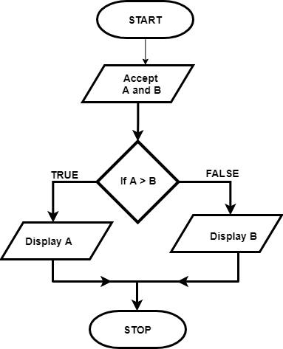
Program Development Steps
To find greatest of two numbers
  STEP 1: Start
  STEP 2: Read two numbers A and B
  STEP 3: if A> B
  Print A is greater
  else
  Print B is greater
  STEP 4: Stop

Slide 17
Program Development Steps
4. Test the Algorithm for Correctness
  The programmer must make sure that the algorithm is correct. The objective is to identify major logic errors early, so that they may be easily corrected
  Test data should be applied to each step, to check whether the algorithm actually does what it is supposed to
  Our simple example ( area and circumference of a circle), it is quite easy to check by submitting some values for radius (r) and walking through the algorithm to see whether the resulting output is correct for each input

Slide 18
Program Development Steps
5. Code the Algorithm
  After all the design considerations have been met and when the algorithm is finalised, code it using a suitable programming language
6. Compile
  Syntax errors can be identified
  Syntax errors - program statements does not adhere to the programming language
    These errors occur mostly due to miss typed characters, symbols, missing punctuations, etc.
  If there are no syntax errors the program gets compiled and it produces an executable program

Slide 19
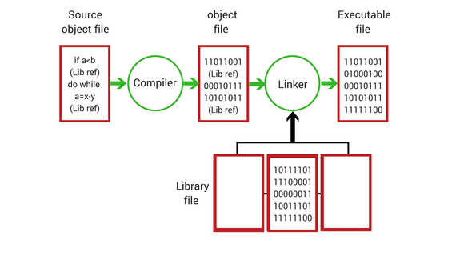
Program Development Steps

Slide 20
Program Development Steps
7. Run the Program
  Executable program generated after compilation can then be executed
  While the program is running runtime errors can be identified
  Runtime errors occur while executing the program and those are mostly due to incorrect inputs
    Example
      Result = 15 / 0;

Slide 21
Program Development Steps
8. Test, Document and Maintain the Program
  Test the running program using test data to make sure program is producing correct output(s)
    Run the program several times using different sets of data to make sure that it works correctly
  All the steps involved in developing the program algorithm and code should be documented for future reference
  Programmers should also maintain and update the program according to new or changing requirements
    Maintaining and updating the program involves modifying a program to remove previously undetected errors and to keep it up-to-date as government regulations or company policies change

Slide 22
Programming Language
A programming language is a set of rules that provides a way of telling a computer what operations to perform
English is a natural language. It has words, symbols and grammatical rules
A programming language also has words, symbols and rules of grammar
The grammatical rules are called syntax
Each programming language has a different set of syntax rules

Slide 23
Why are there so many Programming Languages?
Programming languages have evolved over time as better ways have been developed to design them
  First programming languages were developed in the 1950s
  Since then many languages have been developed
Different programming languages are designed for different types of programs
  FORTRAN - numerical computing
  Simula - simulation
  Prolog - natural language processing
  Lisp - artificial intelligence
  C, C++, Java, C# and Visual Basic - used to develop a variety of applications

Slide 24
Levels of Programming Languages
High-level program
class Triangle {
...
float surface()
return b*h/2;
}
Low-level program
LOAD r1,b
LOAD r2,h
MUL r1,r2
DIV r1,#2
RET
Executable Machine code
0001001001000101001001001110110010101101001...

Slide 25
Generations of Programming Languages
  First Generation Languages
  Second Generation Languages
  Third Generation Languages
  Fourth Generation Languages
  Fifth Generation Languages

Slide 26
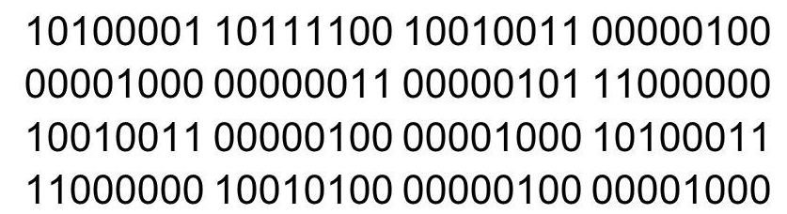
First Generation Languages
  Machine language
    Machine language is a collection of binary digits or bits that the computer reads and interprets
    Machine language is machine dependent as it is the only language the computer can understand
    Very efficient code but very difficult to write
    Example

Slide 27
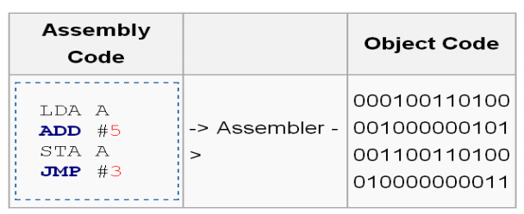
Second Generation Languages
  Assembly language
    A program written in assembly language consists of a series of instructions mnemonics (ADD,SUB,MUL,Div,MOV,etc.) that correspond to a stream of executable instructions, when translated by an assembler, that can be loaded into memory and executed
    Computers do not understand the assembly code, so we need a way to convert it to machine code, which the computer does understand
    Assembly language programs are translated into machine language by a program called an assembler

Slide 28
Third Generation Languages
Closer to English but included simple mathematical notation (High-Level Languages)
  Programs written in source code which must be translated into machine language programs called object code
  The translation of source code to object code is accomplished by a machine language system program called a compiler or interpreter
  Common third generation languages
    FORTRAN, COBOL, C, C++, Pascal, Java, etc.

Slide 29
Fourth Generation Languages
A very high-level language (4GL) that requires fewer instructions to accomplish a task than a third generation language - non-procedural language
Used with databases
  Query languages
  Report generators
  Forms designers
  Application generators
Example : SQL, NOMAD and FOCUS

Slide 30
Fifth Generation Languages
Declarative languages
Functional : Lisp, Scheme, SML
  Also called applicative
  Everything is a function
Logic: Prolog
  Based on mathematical logic
  Rule- or Constraint-based
Beyond Fifth Generation Languages
  Though no clear definition at present, natural language programs generally can be interpreted and executed by the computer with no other action by the user than stating their question.
  Limited capabilities at present

Slide 31
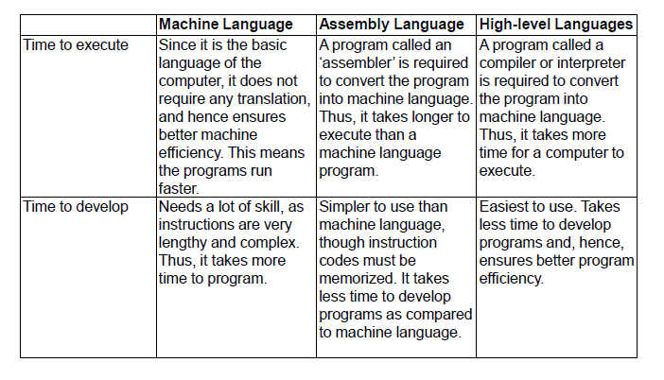
Comparison

Slide 32
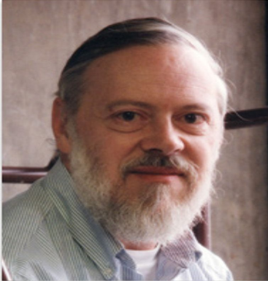
History of C
Originally developed in the 1970’s by Dennis MacAlistair Ritchie at Bell Telephone Laboratories, Inc. (now a part of AT&T)
Evolved from two previous programming languages, BCPL and B in Bell Lab.
  Many of its principles and ideas were taken from the earlier language B and B's earlier ancestors BCPL and CPL
Used to develop UNIX and modern operating systems
Hardware independent (portable)
By late 1970's C had evolved to "Traditional C“
Many of todays leading operating systems are written in C and/or C++
C is mostly hardware independent - With careful design, it’s possible to write C programs that are portable to most computers
Standardization
  Many slight variations of C existed, and were incompatible
  Committee formed to create a "unambiguous, machine-independent" definition
  ANSI C, ISO C and Standard C

Slide 33
Why learn C?
A number of programming languages in the world today
  C++, Java, Ada, Basic, COBOL, Perl, Pascal, Smalltalk, FORTRAN, etc. and other higher level languages that provide much larger built-in libraries
Reasons to learn C
  A common language in the world today
  A simple and small language - with 32 keywords
  A stable language
    The ANSI standard for C was created during1983 -1989
    The language has not been revised since then. In newer languages, the standard changes regularly and often, so a good code written today may not compile properly tomorrow

Slide 34
Why learn C?
  Programs written in C are very efficient and fast
    due to its variety of data types and powerful operators
    a well-written C program is likely to be as quick as a well-written program in any other high-level language
  Powerful and flexible language which helps system developers to deliver various complex tasks with ease
    used for developing diverse projects as operating systems, word processors, graphics, spreadsheets, and even compilers for other languages
  Core language
    a number of common and popular languages are based on C
  Portable language
    means that a C program written for one computer system (an IBM PC, for example) can be run on another system (a DEC VAX system, perhaps) with little or no modification

Slide 35
Why learn C?
Ability to extend itself
    a C program is basically a collection of various functions supported by C library (also known as header files)
    we can also add our own functions to the C library
    these functions can be reused in other applications or programs by passing pieces of information to the functions, thus creating useful & reusable code
These features shows that C is an excellent choice for your first programming language
Having learnt C, it will be much easier to learn languages that are largely or in part based upon C
  like C++, Java, Perl, etc.

Slide 36
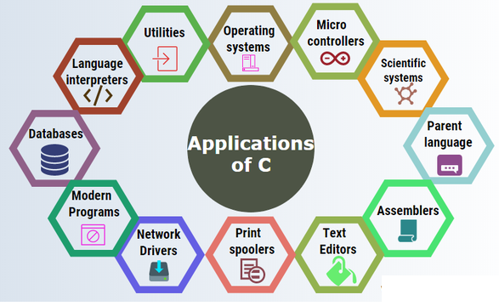
Areas of Application
    https://www.toptal.com/c/after-all-these-years-the-world-is-still-powered-by-c-programming

Slide 37
The Standard C Library
A programmer can create his own functions
  Advantage: the programmer knows exactly how it works
  Disadvantage: time consuming
Programmers will often use the C library functions
  Use these as building blocks
Avoid re-inventing the wheel
  If a premade function exists, generally best to use it rather than write your own
  Library functions carefully written, efficient, and portable

Slide 38
Typical C Program Development Environment
C programs typically go through six phases to be executed.
These are
  Edit
  Preprocess
  Compile
  Link
  Load
  Execute

Slide 39
Typical C Program Development Environment
Phase 1 consists of editing a file
This is accomplished with an editor program
Two editors widely used on Linux systems are vi and emacs
Software packages for the C/C++ integrated program development environments such as Eclipse and Microsoft Visual Studio have editors that are integrated into the programming environment
You type a C program with the editor, make corrections if necessary, then store the program on a secondary storage device such as a hard disk
C program file names should end with the .c extension

Slide 40
Typical C Program Development Environment
In Phase 2, provide the command to compile the program
The compiler translates the C program into machine language-code (also referred to as object code)
In a C system, a preprocessor program executes automatically before the compiler’s translation phase begins
It indicates that certain manipulations are to be performed on the program before compilation
  These manipulations usually consist of including other files in the file to be compiled and performing various text replacements

Slide 41
Typical C Program Development Environment
In Phase 3, the compiler translates the C program into machine-language code
A syntax error occurs when the compiler cannot recognize a statement because it violates the rules of the language.
Syntax errors are also called compile-time errors

Slide 42
Typical C Program Development Environment
The next phase (Phase 4) is called linking
C programs typically contain references to functions defined elsewhere, such as in the standard libraries or in the private libraries of groups of programmers working on a particular project
A linker links the object code with the code for the missing functions to produce an executable image (with no missing pieces)

Slide 43
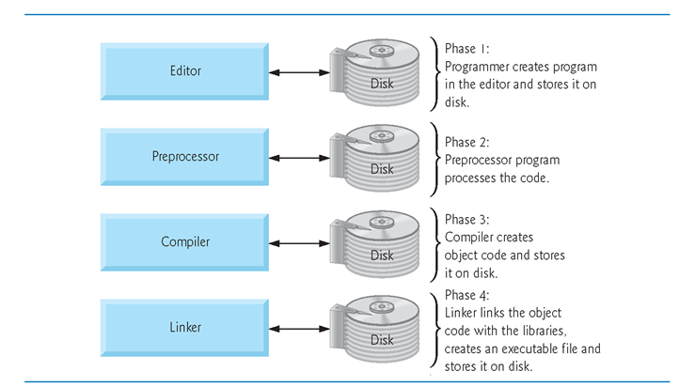
Typical C Program Development Environment

Slide 44
Typical C Program Development Environment
The fifth phase is called loading
Before a program can be executed, the program must first be placed in primary memory
  This is done by the loader, which takes the executable image from disk and transfers it to the primary memory
Finally, the computer, under the control of its CPU, executes the program one instruction at a time

Slide 45
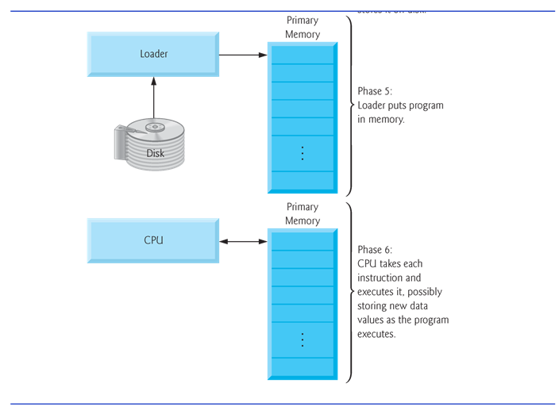
Typical C Program Development Environment

Slide 46
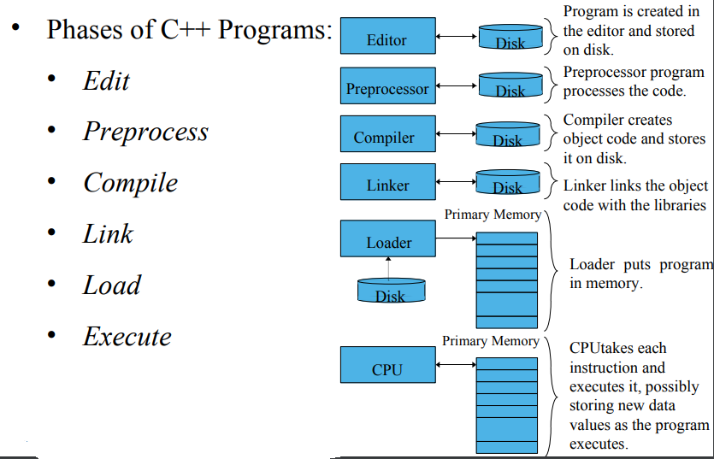
Six Phases – C Program Development Environment

Slide 47
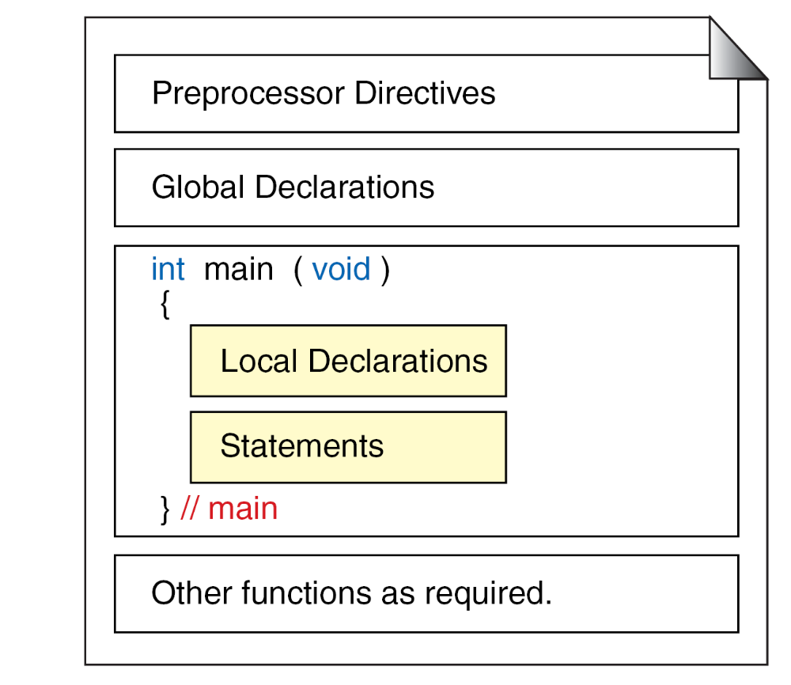
Structure of a C Program

Slide 48
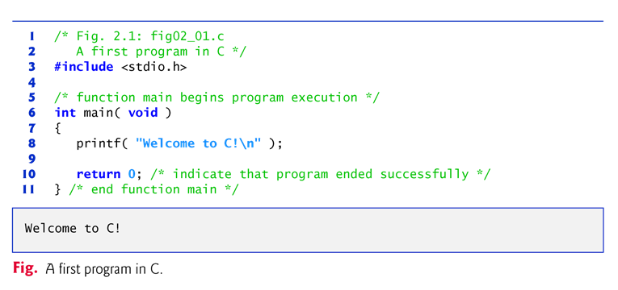
A Simple C Program

Slide 49
A Simple C Program
Lines 1 and 2
    /* Fig. 2.1: fig02_01.c
    A first program in C */
begin with /* and end with */ indicating that these two lines are a
comment
Comments - to document programs and improve program readability
Comments do not cause the computer to perform any action when the program is run
Comments are ignored by the C compiler and do not cause any machine-language object code to be generated
Comments also help other people read and understand your program

Slide 50

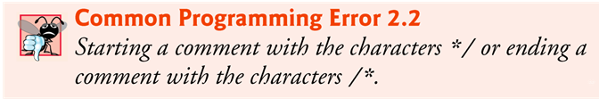
A Simple C Program
Common Programming Errors

Slide 51
A Simple C Program
// single-line comments
  Everything from // to the end of the line is a comment
  These can be used as standalone comments on lines by themselves or as end-of-line comments to the right of a partial line of code
  Some programmers prefer // comments because they’re shorter and they eliminate the common programming errors that occur with /* */ comments

Slide 52
A Simple C Program
Line 3
  #include <stdio.h>
is a directive to the C preprocessor
Lines beginning with # are processed by the preprocessor before the program is compiled
Line 3 - tells the preprocessor to include the contents of the standard input/output header (<stdio.h>) in the program
This header contains information used by the compiler when compiling calls to standard input/output library functions such as printf

Slide 53
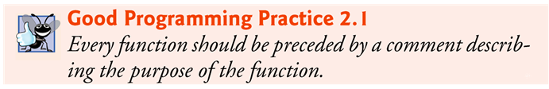
A Simple C Program
Line 6
    int main( void )
is a part of every C program.
The parentheses after main indicate that main is a program building block called a function
C programs contain one or more functions, one of which must be main.
Every program in C begins executing at the function main
The keyword int to the left of main indicates that main “returns” an integer (whole number) value
The void in parentheses here means that main does not receive any information

Slide 54
A Simple C Program
A left brace, {, begins the body of every function (line 7).
A corresponding right brace ends each function (line 11).
This pair of braces and the portion of the program between the braces is called a block
Line 8
    printf( "Welcome to C!\n" );
instructs the computer to perform an action, namely to print on
the screen the string of characters marked by the quotation marks
A string is sometimes called a character string, a message or a literal

Slide 55
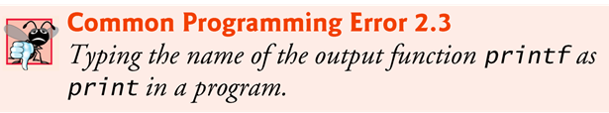
A Simple C Program
The entire line, including printf, its argument within the parentheses and the semicolon (;), is called a statement
Every statement must end with a semicolon (also known as the statement terminator)
When the preceding printf statement is executed, it prints the message Welcome to C! on the screen
The characters normally print exactly as they appear between the double quotes in the printf statement

Slide 56
A Simple C Program
Notice that the characters \n were not printed on the screen
When encountering a backslash in a string, the compiler looks ahead at the next character and combines it with the backslash to form an escape sequence
The escape sequence \n means newline
When a newline appears in the string output by a printf, the newline causes the cursor to position to the beginning of the next line on the screen

Slide 57
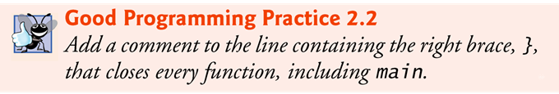
A Simple C Program
Line 10
    return 0; /* indicate that program ended successfully */
is included at the end of every main function
The keyword return is one of several means we’ll use to exit a function
When the return statement is used at the end of main as shown here, the value 0 indicates that the program has terminated successfully.
The right brace, }, (line 12) indicates that the end of main has been reached.

Slide 58
A Simple C Program
Standard library functions like printf and scanf are not part of the C programming language.
  For example, the compiler cannot find a spelling error in printf or scanf
When the compiler compiles a printf statement, it merely provides space in the object program for a “call” to the library function
But the compiler does not know where the library functions are—the linker does
When the linker runs, it locates the library functions and inserts the proper calls to these library functions in the object program

Slide 59
A Simple C Program
Now the object program is complete and ready to be executed
For this reason, the linked program is called an executable
If the function name is misspelled, it’s the linker that will spot the error, because it will not be able to match the name in the C program with the name of any known function in the libraries

Slide 60
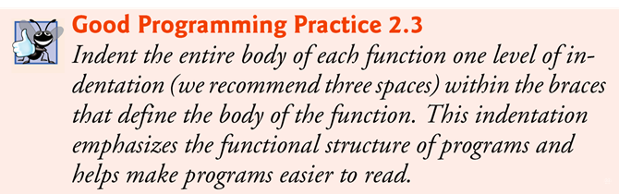
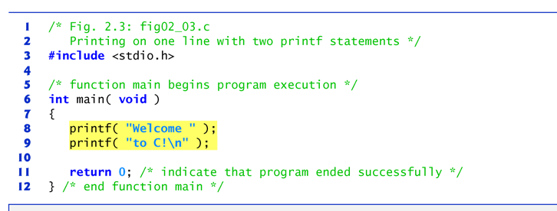
A Simple C Program

Slide 61
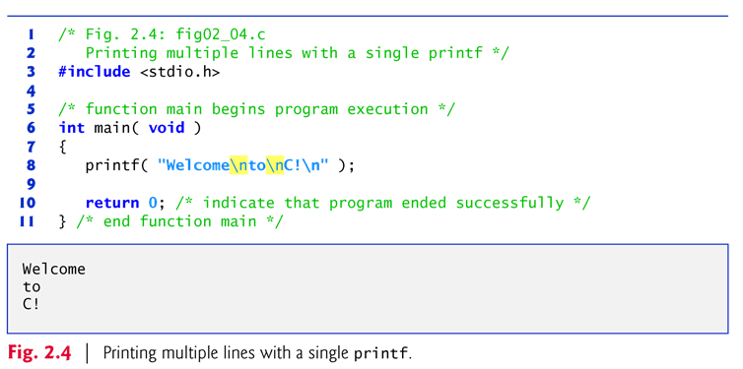
A Simple C Program
One printf can print several lines by using additional newline characters as in Fig. 2.4
Each time the \n (newline) escape sequence is encountered, output continues at the beginning of the next line

Slide 62
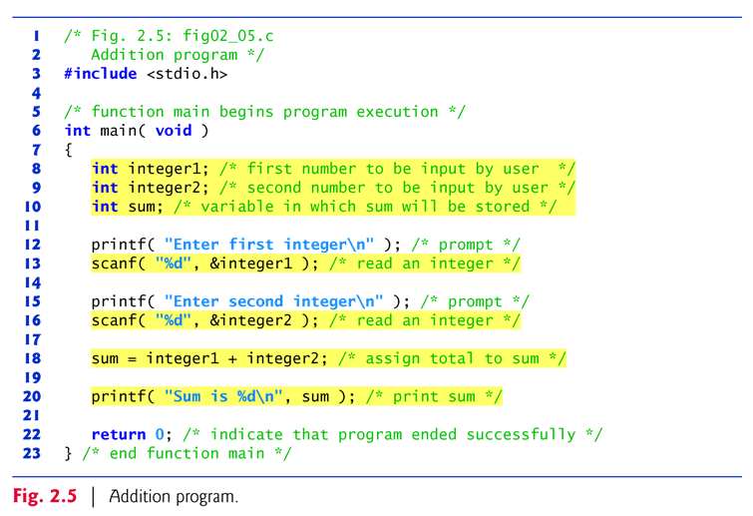
Anther Simple C Program – Addition of Two Integers

